Slide 1
Implementation Plan: Women’s Lacrosse
Divisional Forma
Implementing Divisions in the WVSLA
Women's’ Game
(Amending WVSLA 2019 Rules, Appendices C & D)

Slide 2
Objectives of a 2-Division Alignment
Provide the most fair and equal play on the field within each division
Foster the development of players through equal competition
Encourage growth within WV through the elimination of competitive barriers to entry by new teams
Provide a mechanism for team in transition to move up or down a division to align with current skills, abilities, and experience

Slide 3
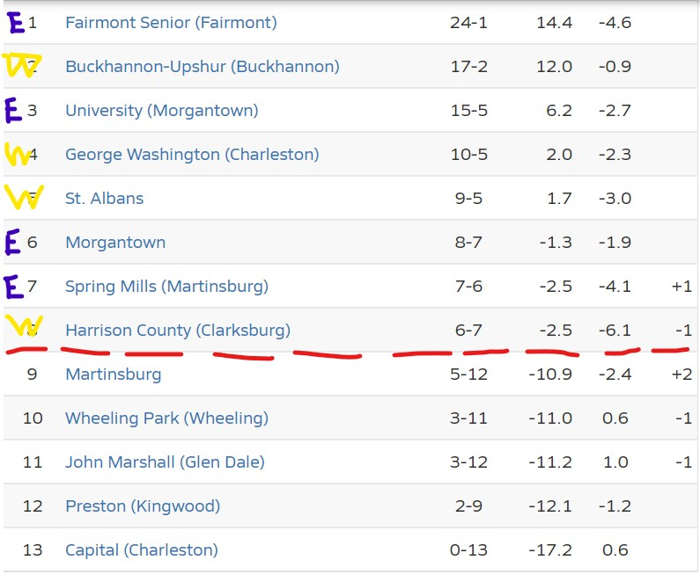
Division Split Breakdown
Division 1:
(E) Fairmont Senior HS
(E) University HS
(E) Morgantown HS
(W) Buckhannon-Upshire HS
(W) George Washington HS
(W) St. Albans HS
Division 2:
(E) Spring Mills HS
(W) Harrison County
(E) Martinsburg HS
(W) Wheeling Park HS
(W) John Marshall HS
(E) Preston HS
(W) Capital HS
(E) Musselman HS
(E) Hedgesville HS
(E) Jefferson County
(W) Brooke HS (Provisional – 2023)

Slide 4
Implementation – Base
Each Division is a single “group” without geographic regions.
There MUST be at least 6 teams in a division at all times.
  If we cannot get 6 teams in a division at any point in time then we need to look at a different system.
Barring extenuating circumstances, if a team wins Division 2 two (2) years in a row it MUST move up, and if a team finishes last in Division 1 two (2) years in a row it MUST move down.
Players selected for the East/West All-Star game will play on teams in alignment with the regions in effect for the 2022 season, until or unless those regions are re-evaluated. Brooke is in the West. Hedgesville & Jefferson are in the East.

Slide 5
Implementation – Regular Season
Minimum games:
  For both Division 1 & Division 2, all teams play a minimum of eight (8) games against Division opponents
  All team must play at least two (2) games against opponents from the opposite Division to qualify for post-season (playoffs, awards)
  Teams may play any single opponent no more than twice in the regular season in the calculation for playoff eligibility
Out-of-division contests only serve as tiebreaker criteria in the standings
There are no limits on total games, either within or across divisions
Games beyond the minimum do count for playoff standings
  In-Division games are used to calculate win percentage for rankings
Barring extenuating circumstances, a WVSLA forfeit disqualifies a team from participating in the playoffs

Slide 6
Implementation - Playoffs
Top (8) teams make the playoffs based on regular season win percentages of Divisional contests. Cross-Divisional rankings only serve as tiebreakers. Out of state contests do not count towards win percentage.
The bracket is a standard 8-team bracket.
In there are less than 8 teams in a division, first-round “Byes” are extended to the top seed(s).
The higher-seeded team hosts or selects venues, except by mutual agreement.
Start time and game date should be worked out by mutual agreement, with consideration given to travel distances for the visiting teams.
Must be at least 2 days in between playoff games, except by mutual agreement. (Example: teams play Monday, winner wouldn't be able to play again until Thursday)
If a qualifying team withdraws from playoff contention, the next team in the standings moves up. (Note: Team #9 should remain ready to play @ Team 1)

Slide 7
Implementation (Future)
Each year, a team can apply/appeal for a change in division if they feel that it is warranted.
New teams will enter in Division 2 unless there is a justification (approved by the Board) to enter in Division 1.
Realignment may occur:
  With the addition of multiple new teams
  If there is a competitive imbalance
In instances of a competitive imbalance, the WVSLA Board may recommend realignment of individual teams.

Slide 8
Reference – Travel Distance Chart

